Slide 1
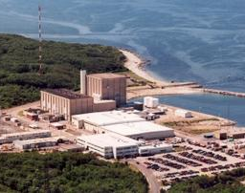
Decommissioning
Pilgrim
Mary Lampert
Pilgrim Watch
What is Decommissioning, and What Should be Done to
Protect our Communities?

Slide 2
Overview
What is likely to happen at Pilgrim?
  Spent Fuel
  Site Restoration
  Decommissioning Timeline
  Economics

Slide 3
What is Decommissioning?
Most People assume decommissioning Pilgrim will include:
Removing all radioactivity
Dismantling and removing the reactor
Demolishing and removing all existing buildings/structures
Safely storing spent fuel and other wastes until they are
eventually moved off-site
Removing any contaminated soil
Restoring the site to its original condition
It Won’t!

Slide 4
NRC’s Definition of Decommissioning
NRC’s definition of decommissioning is much narrower:
  “The safe removal of a facility from service and reduction of residual radioactivity to a level that permits termination of the NRC license.”
NRC’s definition does not include:
  The removal or storage of spent fuel
  Demolition of decontaminated structures
  Site restoration activities after residual radioactivity has been removed
NRC Rules restrict use of the Decommissioning Trust Fund to reducing “radiological radioactivity.”

Slide 5
NRC’s Three Decommissioning Options
Decontamination (DECON)
  Structures and components contaminated with radioactivity are either cleaned, or removed and shipped to a licensed radioactive dump site
Safe Storage (SAFSTOR)
  The facility is placed in nuclear limbo for up to 60 years for later decontamination
Entombment (ENTOMB)
  The facility is basically covered over in cement and left forever.
    Entombment has never been used.

Slide 6
WHAT SHOULD BE DONE TO PROTECT OUR COMMUNITIES?

Slide 7
NO MATTER WHO OWNS PILGRIM . . .
Three issues must be addressed:
1. Spent Fuel
2. Site Restoration
3. Money – is there enough?

Slide 8
1. Spent Fuel
Spent Fuel should be moved out of the spent fuel pool and into hardened dry cask, located on high ground to avoid flooding, as soon as possible.
Here is why.

Slide 9
Pilgrim’s Spent Nuclear Fuel
All nuclear fuel used for the past 45 years remains on-site.
Most is now stored in a spent fuel pool located in the upper floor of the reactor.
Some was moved outside, now in dry casks on a concrete pad near the reactor.
Most of the fuel will remain in the reactor until shut-down.
Eventually, all of the spent fuel will be moved into dry casks.
The spent fuel in dry casks will remain on site for decades, perhaps indefinitely.

Slide 10
What’s the Problem with Pilgrim’s Spent Fuel Pool?
Location: Pilgrim’s pool is located in the upper floor of the reactor. It is outside primary containment with a thin and vulnerable roof overhead.
Crowded: Pilgrim’s pool was designed to hold 880 used fuel assemblies; it now holds 2,990 (September 2017). When Pilgrim shuts-down, 580 additional fuel assemblies, now in the reactor, will be moved into the pool. Pool is licensed for a maximum capacity of 3,859 assemblies.
Boraflex panels were added between Pilgrim’s pool assemblies to protect against overheating. – Entergy says about 900 are degrading (April 2017)
Risk of Fire: If pool loses water simply to the top of the assemblies, a pool fire can occur, releasing radiation.

Slide 11
CONSEQUENCES OF A SPENT FUEL POOL FIRE
2016 Study: Major Spent Fuel Pool fire could contaminate over 38,000 square miles of land - almost four times the area of Massachusetts - and force millions to evacuate.
2006 Pilgrim Study: $488 Billion dollars, 24,000 cancers, land uninhabitable for hundreds of miles downwind
These risks will be reduced by transferring all the spent fuel from the pool to dry casks as soon as possible after shutdown.

Slide 12
Economics Will Drive Entergy’s
Decision When to Empty the Pool
Before shutdown, Entergy has to pay for moving fuel from the pool into casks storage out of its pocket.
Post-shutdown, NRC allows use of the Decommissioning Trust Fund to pay to move fuel from the spent fuel pool into dry casks.
Once power generation has ceased and all of the spent fuel is put in dry casks, Entergy can dramatically reduce its work force (to as low as 15) and its spent fuel storage costs.
The fuel that is now in Pilgrim’s reactor and spent fuel pool probably will be moved into dry casks within 5 or so years after Pilgrim shuts down.

Slide 13
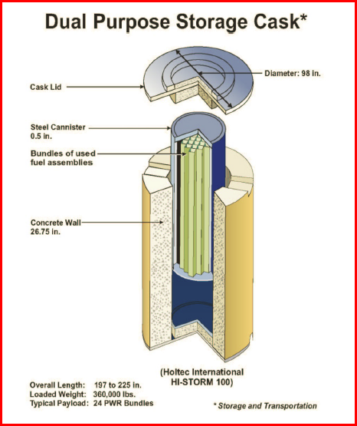
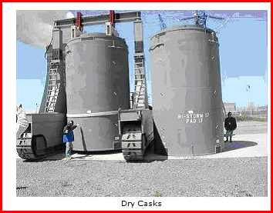
DRY CASK STORAGE

Slide 14
DRY CASK STORAGE SAFETY ISSUES
Dry cask storage is far safer than pool storage, but there are problems… potential leakage
According to the Nuclear Regulatory Commission (NRC):
  • The thin (0.5”) stainless steel canisters may crack within 30 years.
  • Currently, no technology exists to inspect, repair or replace cracked canisters.
  • With limited monitoring, we will only know after a canister leaks radiation.
  Each dry cask contains ½ as much Cesium-137 as the total released at Chernobyl

Slide 15
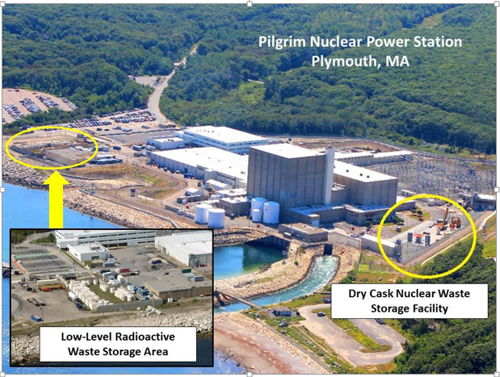
Pilgrim’s Dry Cask & LLRW Storage Plan
Vulnerable to: Sea-Level Rise, Coastal Storm Damage, Flooding, Surge, Salt Water
Degradation
Dry cask pad 150’ from shore, 4’ above FEMA Flood Level
Low Level Radioactive Waste Casks 30’ from coastal bank

Slide 16
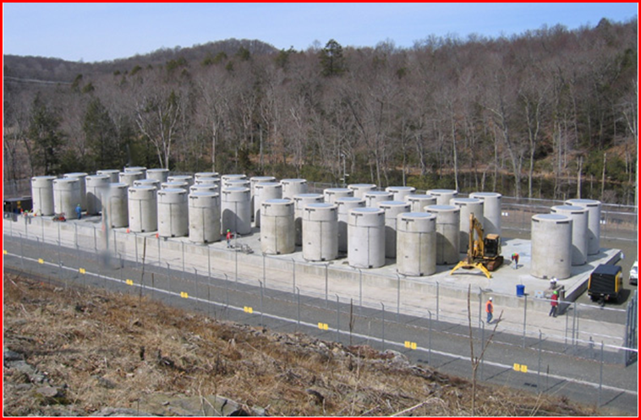
Security - Pilgrim’s Plan
“Candlepin Bowling for Terrorists”

Slide 17
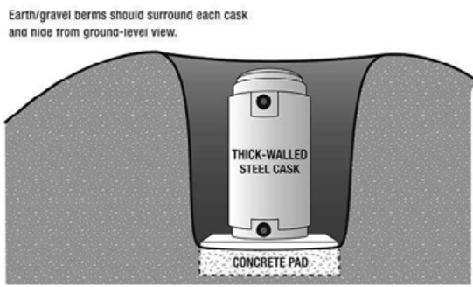
Improved Dry Cask Storage Security
Earth/gravel berms should surround each cask
and hide it from ground level view.
Earth/gravelberm

Slide 18
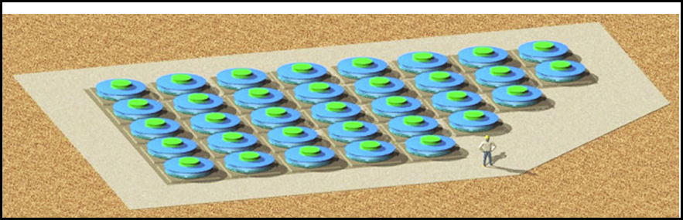
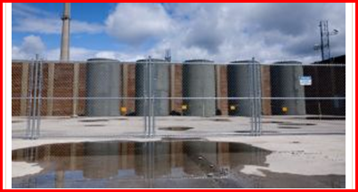
Three Alternate Security Solutions
Casks in Reinforced Concrete Building
Submerged Casks, Holtec-Hi-Storm U (more secure, but unable to inspect)
Blast Shield

Slide 19
Spent Fuel After Shutdown
Pilgrim’s spent fuel will likely remain on-site for many years.
Offsite Storage Options are not available- neither approved nor developed.
  Permanent Repository- Yucca Mountain
  Proposed Interim Sites- West Texas & New Mexico
Nevertheless, NRC & industry predict, absent facts, an interim facility will be available in 2026 and deep geological site in 2048. VY estimate 38 yrs. to move fuel.

Slide 20
Until there are Viable Offsite Solutions:
NRC’s Nuclear Waste Rule Allows:
  Spent fuel to stay in either the pool or in dry casks for 60 years
  During subsequent 300 years, spent fuel assemblies may be kept in dry casks onsite – changing pad and casks every 100 years. Who will pay?

Slide 21
2. Site Restoration (part 1)
(No Matter Who Owns Pilgrim)
Key Issues:
How clean is clean – Who decides?
Are all structures removed?
How long will it take?

Slide 22
Site Restoration (part 2)
How Clean is Clean?
NRC’s Radiation Cleanup Standard
Release site to unrestricted use: 25 millirem per year total effective dose equivalent to an average member of the critical group - limit includes the dose from drinking groundwater
Release site to restricted use: 100 or 500 millirem for restricted use.
Massachusetts may, but has not set a more conservative standard that applies to decommissioning reactor sites
Unanswered Questions
    How is dose determined? How far down into the soil do they test?
      Is Entergy required to return Pilgrim’s site to “greenfield” for unrestricted use?

Slide 23
Cleanup Standards and Health Effects
Lifetime Exposure (millirem/year) | 70 year Risk of Developing Any Cancer
Current MA limit for Unrestricted 10 Use for its licensees. Does not Apply to Pilgrim, an NRC licensee | 70/100,000 (0.7/1,000)
NRC Limit for Unrestricted Use 25 | 175/100,000 (1.75/1,000)
NRC & MA Limits for 100 Restricted Use | 700/100,000 (7/1,000)
NRC & MA Limits for 500 Restricted Use | 3,500/100,000 (35/1,000)
Risk of Fatal Cancer is one half to two thirds the risk of developing any cancer. | Reproductive disorders occur at lower levels of radiation exposure than cancer.
The level of risk for radionuclides is significantly higher than for chemicals. | DEP’s risk level goal for a mixture of chemicals is a lifetime cancer incidence risk of 1 in 100,000. DEP risk level goal for one chemical is a lifetime cancer incidence risk of 1 in a million.
 | Based on Radiation: BEIR VII Phase 2. Washington, DC: The National Academies Press; 2006

Slide 24
Site Restoration (Continued)
Not all structures onsite are removed
What is removed?
Major radioactive components, such as the reactor vessel, steam generators, or other components that are comparably radioactive are removed
Structures removed to 3 feet below grade (reactor building foundation is 25.5’ below mean sea level)

Slide 25
Site Restoration (Continued)
Rubblization:
Removal all equipment from buildings
Surfaces decontaminated to required level
Above-grade structures demolished into rubble - buried in the structure's foundation left below ground
Could result in material ranging from gravel-size to large concrete blocks, or a mixture of both.
Site surface then covered, regraded and, landscaped for unrestricted use.

Slide 26
Problems with Rubblization
Contaminated rubble likely to leach into soil impacting groundwater both onsite and offsite.
Water intrusion into the rubble is likely at Pilgrim due to flooding and proximity to the water table.
Potential excavation of contaminated building rubble and soil for use in future construction, resulting in radiation exposure.
Provides a less stable surface than soil/sand due to inevitable space between rubble.
Constitutes, in reality, a low level radioactive waste facility at Pilgrim, without NRC requirements to provide protections equivalent to off-site disposal facilities for low-level radioactive waste; runs counter to existing national policy of encouraging states to manage disposal on a regional basis.

Slide 27
Problems with Rubblization (Continued)
  Temptation to mix clean and contaminated concrete to bring the radioactive intensity down to clearance levels - while not reducing the overall radiation content of the disposed concrete.
  Difficulty in verifying amount of radioactivity present, as major radioactive dose contributors may be completely shielded from field instrument detection by a thin layer of concrete.

Slide 28
3. Economics of Decommissioning
Entergy’s Pilgrim Decommissioning Trust Fund (DTF) is about $900 million- short at least $348 million (if work started today), and probably contains billions less than will be needed if the SAFSTOR option is used, delaying decommissioning for decades.
Decommissioning using SAFSTOR could stretch out over 60 years!
NRC hopes DTF investments will grow more than increased decommissioning costs, but…
  NRC estimates DTF will grow 3.5% to 5% annually
  NRC estimates decommissioning costs will increase 5% to 9% annually

Slide 29
The Economics of Decommissioning (cont)
Other reasons for a Decommissioning Trust Fund shortfall:
DTF only covers removing radioactivity - a fraction of the job.
As is happening in Vermont, Entergy will raid DTF in order to cover their other costs:
Spent Fuel Management, Property Taxes, Emergency Planning,
Insurance, Legal & Lobbying Fees

Slide 30
The Economics of Decommissioning (cont)
What is ‘SAFSTOR’?
Allows Entergy to delay completion of decommissioning for 60 years.
Delays economically productive use of site.
Property values nearby remain depressed.
Contamination onsite is not identified and cleaned up, providing opportunity for contamination to spread – both on and offsite.
Offsite emergency planning will be eliminated after operations cease, placing unfunded burden on state and local communities.
Contributions to the state for environmental monitoring also likely will be eliminated, placing unfunded burden on Mass. Taxpayers.
Workers with specific knowledge of spills and other specific problems will have retired or been let go, likely reducing effectiveness of cleanup.

Slide 31
Possible Consequence of SAFSTOR
Entergy told Vermont Legislators it has no responsibilities past the 60 year SAFSTOR period for Vermont Yankee, even if the job remains unfinished.

Slide 32
Alternative Decommissioning Scenario
Entergy might sell the decommissioning job to Northstar, as it wants to do in Vermont. What would that mean?
Who is Northstar?
World’s largest turnkey decommissioning and facility services contractor
Abatement and demolition contractor
Extensive nuclear experience
Partners with other engineering, environmental, spent nuclear fuel support, waste management transportation & disposal firms. (Areva, WCS, Burns McDonnell)

Slide 33
If Northstar Takes Over Pilgrim Decommissioning
With Approval of NRC and Massachusetts, Entergy would place all spent fuel into dry casks, presumably within 5 years of Pilgrim’s shutdown.
NorthStar would:
  Initiate onsite work
  Decommission and restore nearly the entire Pilgrim site within about 10 years
  Provide financial commitments to assure completion of decommissioning
  Obtain NRC approval for partial release of the site (except the Independent Spent Fuel Storage Installation and switchyard areas) to allow productive use of the area
This sounds good, BUT several questions are raised . . .

Slide 34
NorthStar’s Financial Commitments
If the funds that Northstar commits are inadequate to complete cleanup, how does NorthStar intend to deal with financial short falls?
Will NorthStar pay to guard the spent fuel-about $ 5 million a year- if DOE does not reimburse NorthStar for those costs? Who will pay to replace casks? Is NorthStar, DOE or Holtec responsible? Is Holtec a limited liability company? What guarantee did Holtec provide when it provided the casks?
If the Pilgrim DTF appears to be adequate, why should we believe NorthStar can do the job?
Are NorthStar and its partners limited liability corporations?

Slide 35
Northstar Ownership Worries:
Quick, Cheap, and Dirty?
Will the sale to NorthStar and its decommissioning plan create incentives to cut corners?
Some citizen groups fear the cleanup will be cheap and dirty.
Will there be enough money?
What guarantees and liabilities does Holtec, the cask manufacturer, have?

Slide 36
Nuclear Decommissioning
Citizens Advisory Panel (NDCAP)
Established by Legislature -section 14, Chapter 188, Acts of 2016
Members include:(6) state officials; (8) members appointed by state officials; (2) Entergy officials; (1) representative from the Utility Workers Union America Local 369 who either works or worked at Pilgrim; (1) representative from the Old Colony Planning Council; and (3) appointees from the Town of Plymouth.
The Panel is advisory.
Its duties include: hold at minimum 4 public meetings a year (increased to 10 by the Panel); issue an annual report; serve as a conduit for public information; encourage community involvement; receive reports on decommissioning and the decommissioning trust fund.
At this time, it is unfunded.

Slide 37
RECAP- WHAT SHOULD BE DONE TO BETTER PROTECT OUR COMMUNITIES?
Now is the time for Commonwealth to set groundwork

Slide 38
TO PROTECT OUR COMMUNITIES
Spent Fuel - Spent nuclear fuel assemblies should be moved out of the pool and into hardened dry casks located at higher ground to avoid flooding as soon as possible.
Finances - The Licensee (i.e. Entergy) pays for decommissioning in full, not the Commonwealth’s taxpayers.
Decommissioning Trust Fund – Restrict its use to decommissioning; not taxes and operating expenses.
Timing - Decommissioning should occur ASAP following closure. Do not defer dismantlement & cleanup for decades.

Slide 39
TO PROTECT OUR COMMUNITIES (Continued)
Site Restoration: Site returned to “greenfield” for unrestricted use - radioactivity and chemical contamination cleaned up. Standard less than 10 ml/rem/yr.
Prohibit rubblization: “Rip and ship” to licensed site.
Public Safety:
Retain current offsite emergency planning, funded by licensee, until spent fuel pool is emptied (at least 5 years)
Continue licensee-funded offsite emergency planning, on a reduced level, until fuel leaves the site
MDPH continue and expand offsite radiological monitoring and onsite tritium monitoring. Entergy continue to provide funding.
.

Slide 40
TO PROTECT OUR COMMUNITIES (Continued)
Workers:
Retain Skilled workforce for decommissioning.
Provide job training.
NRC Oversight: Reinstate NRC inspections and oversight during decommissioning
  Currently the NRC has little to no meaningful oversight during decommissioning. There are no resident inspectors and no regular inspections.
  Lack of NRC oversight means licensee compliance with regulations is impossible to verify and enforce on a timely basis. Lack of regular reporting leaves the public in the dark.

Slide 41
TO PROTECT OUR COMMUNITIES (Continued)
Commonwealth: actions to prepare for decommissioning
Establish interagency group to oversee Pilgrim’s decommissioning & legal team in each pertinent state agency
Obtain from licensee: historical site contamination data; agreement to get split samples and to receive a copy of the Preliminary Site Characterization- final site characterization does not occur until two years prior to shutdown.
Review NRC Pilgrim docket (50-293) regularly

Slide 42
Thank you for your interest!
Questions & Discussion
Pilgrim Watch: mary.lampert@comcast.net/www.pilgrimwatch.org

