Slide 1
THREE MILE ISLAND (TMI) Unit 1
Possible Transition from Operating to Decommissioning
Low-Level Waste Advisory Committee Meeting
September 28, 2018
Tom Wolf, Governor Patrick McDonnell, PA DEP Secretary

Slide 2
Background Information
On May 30, 2017, Exelon announced it will retire TMI-1 on or about September 30, 2019.
On June 20, 2017, Exelon submitted a Cessation of Operation Letter to the Nuclear Regulatory Commission (NRC) certifying the company’s intent.
The final shutdown decision will be based, in part, on possible PA legislative actions to help mitigate the station’s severe economic challenges.
PJM Interconnection Reliability Study revealed no implications for the reliability of the electric grid due to TMI-1 shutdown.
NRC maintains regulatory authority throughout the TMI-1 decommissioning transition process.
PA DEP will maintain an independent oversight review of TMI-1 decommissioning transition activities at current staffing level.

Slide 3
TMI Decommissioning Transition Milestones
Decommissioning Transition | SAFSTOR & DECON | Site Restored
T-2 Yrs
T-0
Phase 1
30 Days
Phase 2
≤18 Mos
Phase 3
≈ 5 Yrs
Phase 4
Phase 5
≤60 Yrs
Permanent Shutdown
Decision Announced
Permanent Shutdown
Milestones
Phase 3 – End of Zirc Fire to Fuel Pool Empty
Phase 4 – Fuel in ISFSI to license termination
DTO Staffed
≈18 people
Phase 1 - Defueled
Phase 2 – End of Zirc
Fire Window
Phase 5 –Site Restoration
“Decommissioning”
Implement EOL Exceptions
Implement Decommissioning Project Plan
May 30, 2017
Sept. 30, 2019
Notes:
The station intends to keep full staffing through September 2019. During the 18 months following the shutdown, there will be several staffing reductions at the site. The goal is to provide other opportunities throughout the company for as many employees as possible.
Timeline for the project:
1. Bids will be accepted in 2017/2018.
New Fuel Handling Building Crane will be installed in 2019/2020.
January 2020 – Defueling would begin.
4. Pad Construction will begin in 2019/2020.
5. ISFSI pad will be ready to accept dry casks in 2021/2022.
Approximately 2024 – Fuel is all in dry cask storage and there is no longer a need for Emergency Preparedness. *Security would still be required for the dry cask storage.

Slide 4
Independent Spent Fuel Storage Installation - ISFSI
ISFSI is constructed for the interim storage of spent nuclear fuel (SNF) at a reactor site or away from a reactor site.
ISFSI is licensed separately from a nuclear power plant and is considered an independent installation.
ISFSI is currently being used for storage of SNF at 4 out of 5 nuclear power plant sites in PA due to the lack of permanent repository in the U.S.

Slide 5
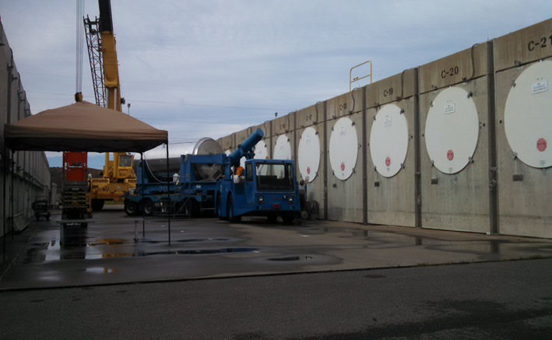
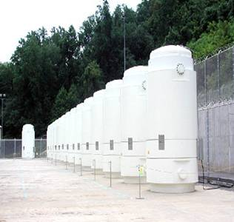
ISFSI
HORIZONTAL
SUSQUEHANNA
(SSES)
VERTICAL
PEACH BOTTOM
(PBAPS)

Slide 6
Decommissioning Strategy SAFSTOR
Under SAFSTOR or “deferred dismantling”, a nuclear plant is maintained for an extended period of time to allow for the radioactivity to decay.
During SAFSTOR, the main components of the plant remain in place, including the reactor vessel and turbine.
All fuel is removed from the reactor vessel and placed in dry storage on-site.
The NRC continues to inspect the site and provides regulatory oversight of maintenance and security.
Notes:
OPTIONAL STATEMENT: This allows the radioactive elements in components to decay to stable elements while the trust fund accrues interest.

Slide 7
Questions?
Rich Janati, M.S. Chief, Division of Nuclear Safety
Administrator, Appalachian Compact Commission
Phone: 717.787.2163 rjanati@pa.gov

